Slide 1

Bank Marketing Campaign
Virtual Internship
29-Apr-2024

Slide 2
Background – Bank Marketing Campaign
ABC bank seeks to improve its marketing strategy for term deposit products by utilizing machine learning (ML) models. By predicting customers' propensity to purchase based on past interactions with banks or other financial institutions, they aim to optimize resource allocation in marketing channels such as telemarketing, SMS/email marketing, etc. Developing an ML model allows ABC Bank to identify and focus on customers with a higher likelihood of purchasing the product, thereby saving resources and reducing the time required in marketing efforts.

Slide 3
Data Understanding
21 Features
Timeframe of the data: 2008-05-05 to 2008-12-05
Total data points: 39083
Assumptions:
The datetime column is calculated based on month and day_of_week
Outliers are removed only in the age column, because they are based on assumptions about human life expectancy and outliers are human error
Categorical data is encoded using One-Hot-Encoder except for ‘y’, because ‘y’ is ordered.

Slide 4
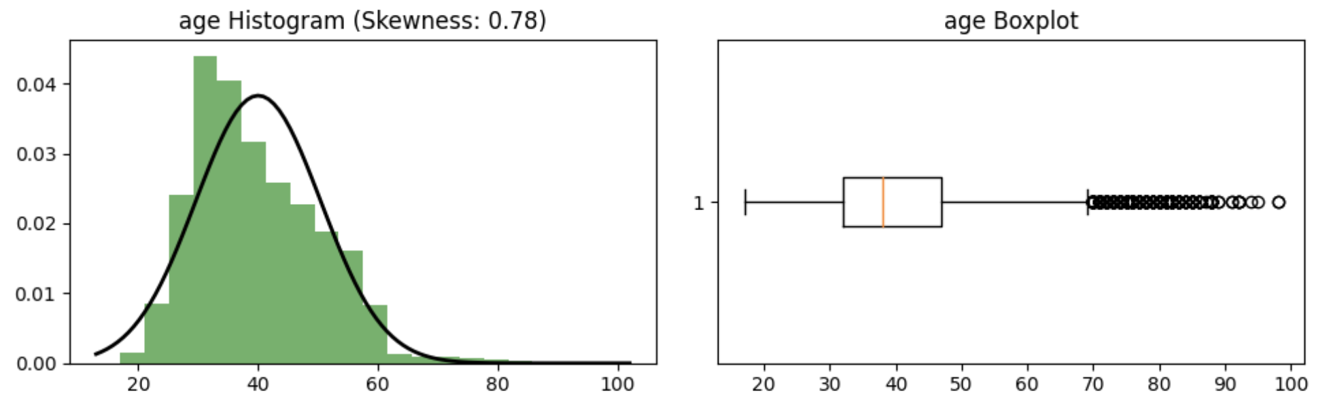
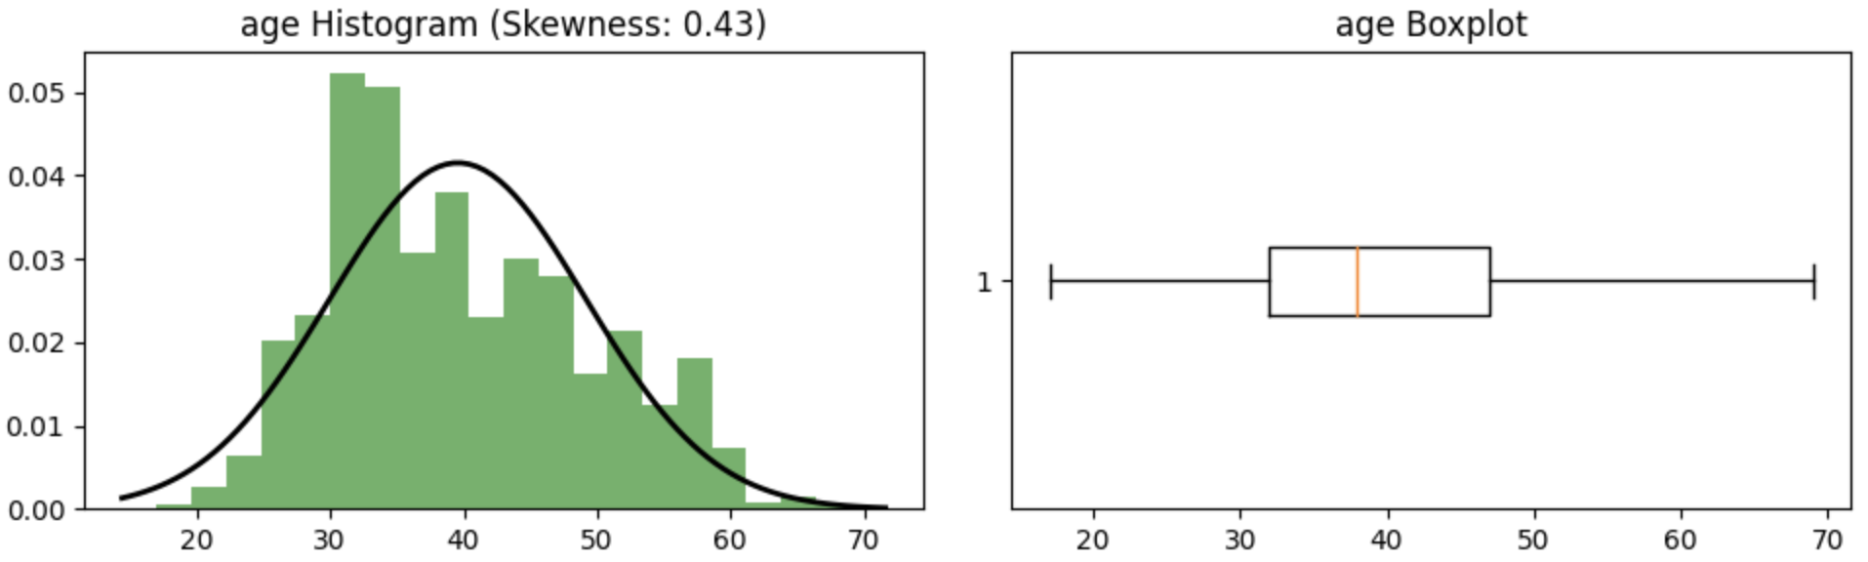
Age
The age column displays the boxplot and distribution in the image above. Assuming a human life expectancy of 70 years, values exceeding 70 are removed according to the boxplot. The image below appears improved after removing the outliers.

Slide 5
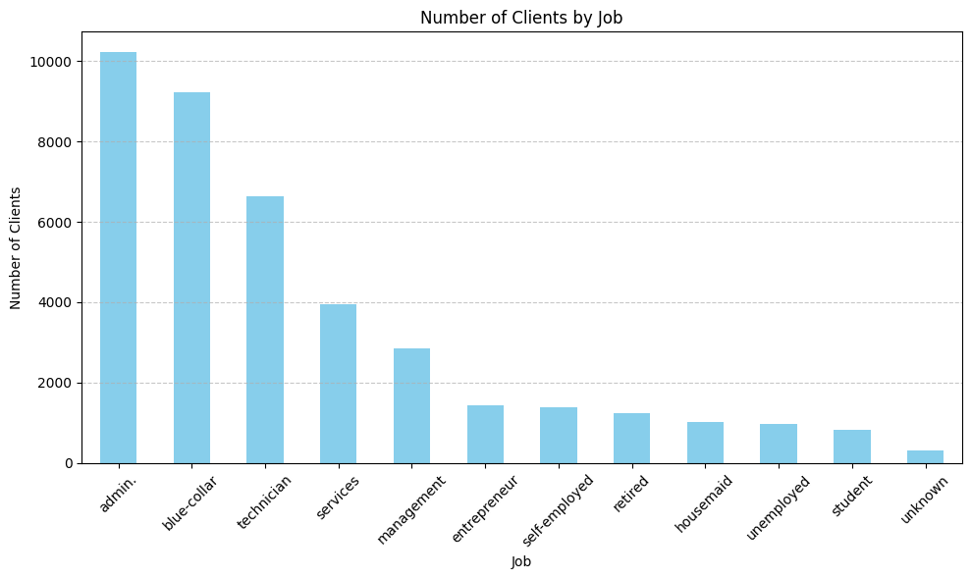
Job
The client mostly has admin jobs, followed by blue-collar and technician roles.

Slide 6
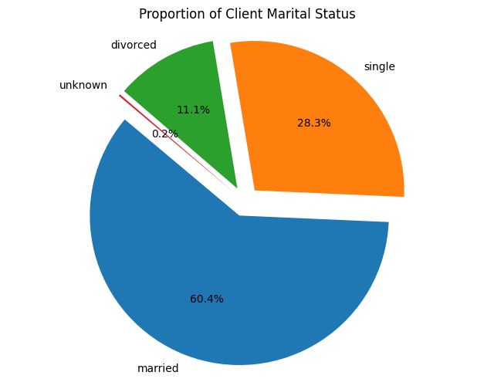
Marital
The majority of clients are married.

Slide 7
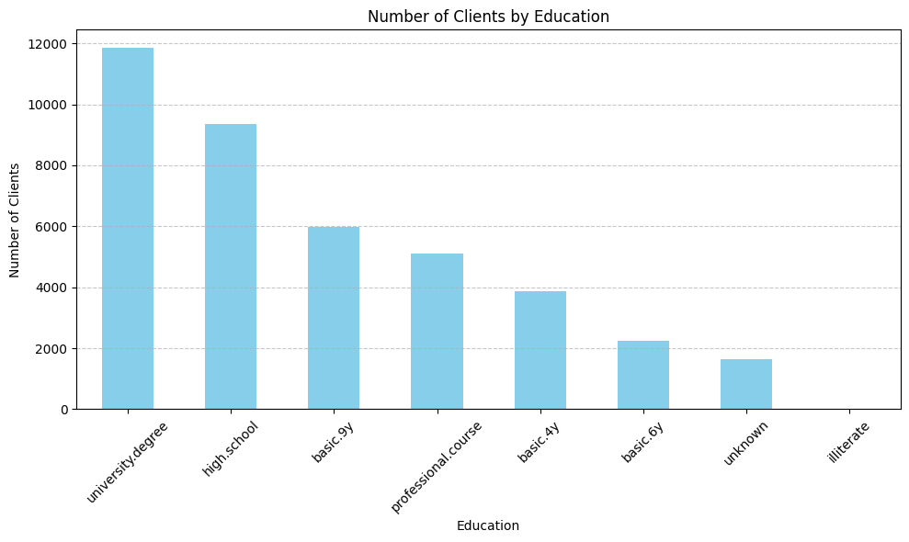
Education
The majority of clients are university graduates.

Slide 8
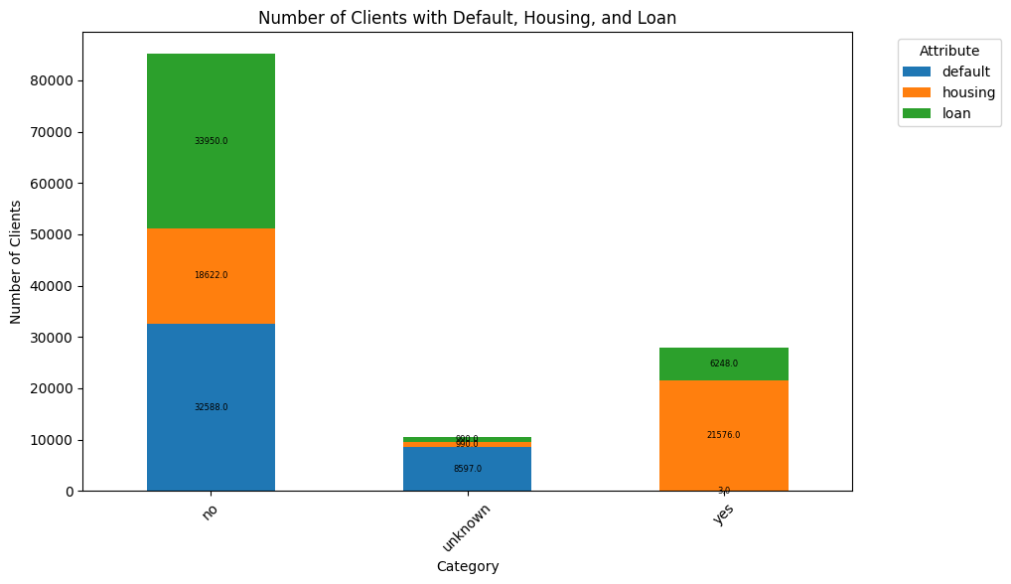
Default, Housing, Loan
The majority of clients doesn’t have credit, mortgage, or personal debt.

Slide 9
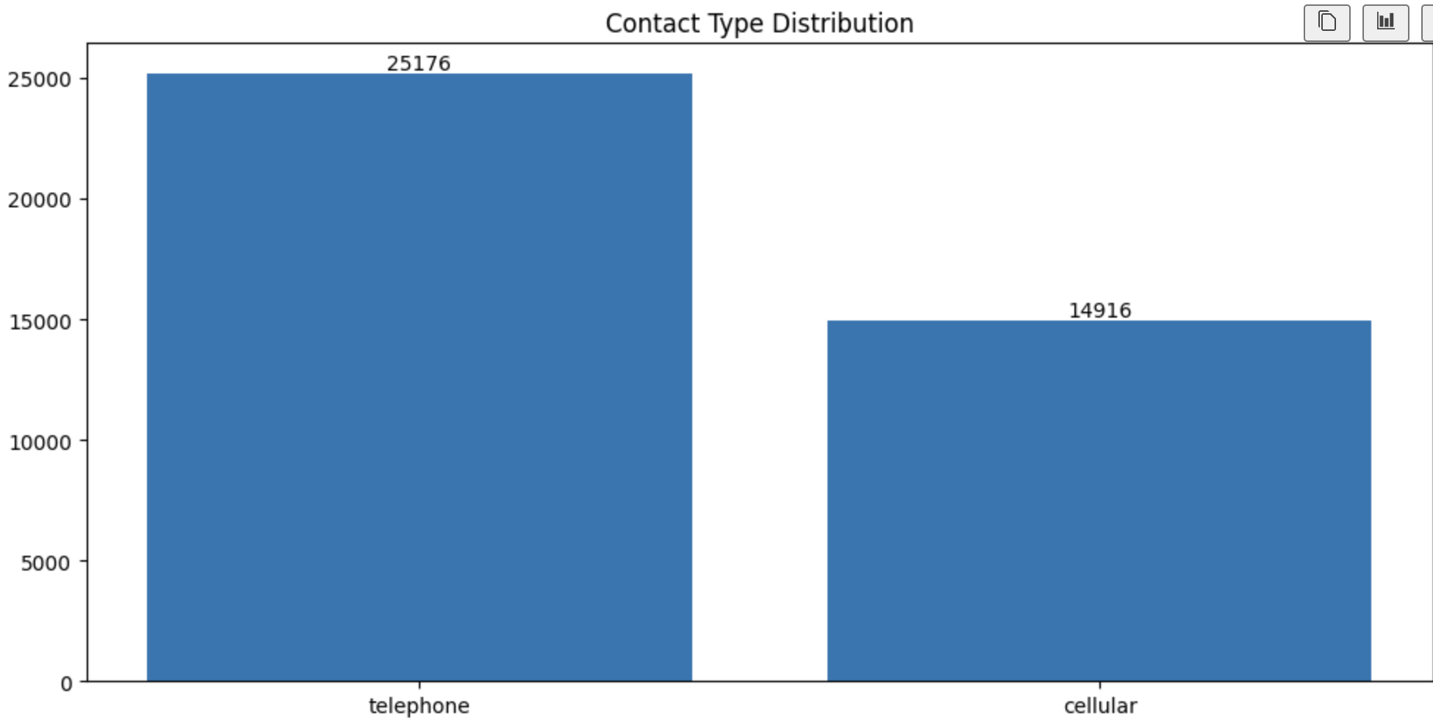
Contact, month, day of week
The majority of clients are contacted by telephone.

Slide 10
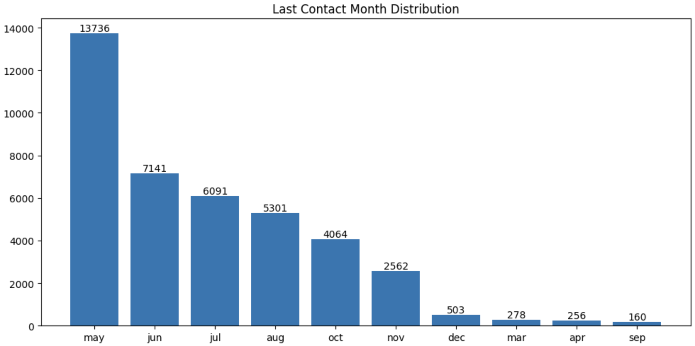
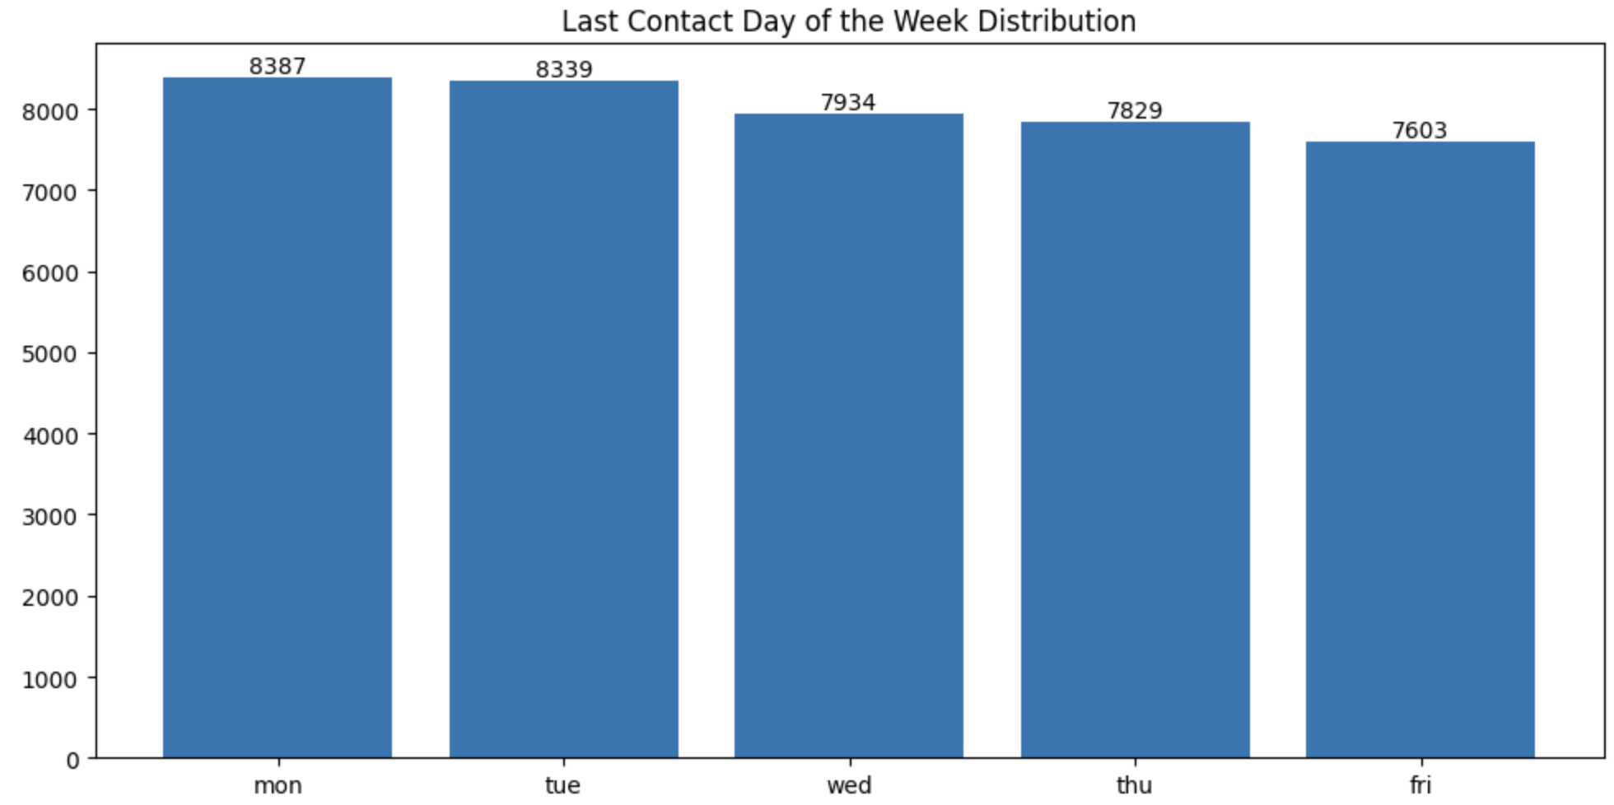
Contact, month, day of week
In the last contact, most clients were contacted in May. Regarding the days of the week, there was no significant difference.

Slide 11
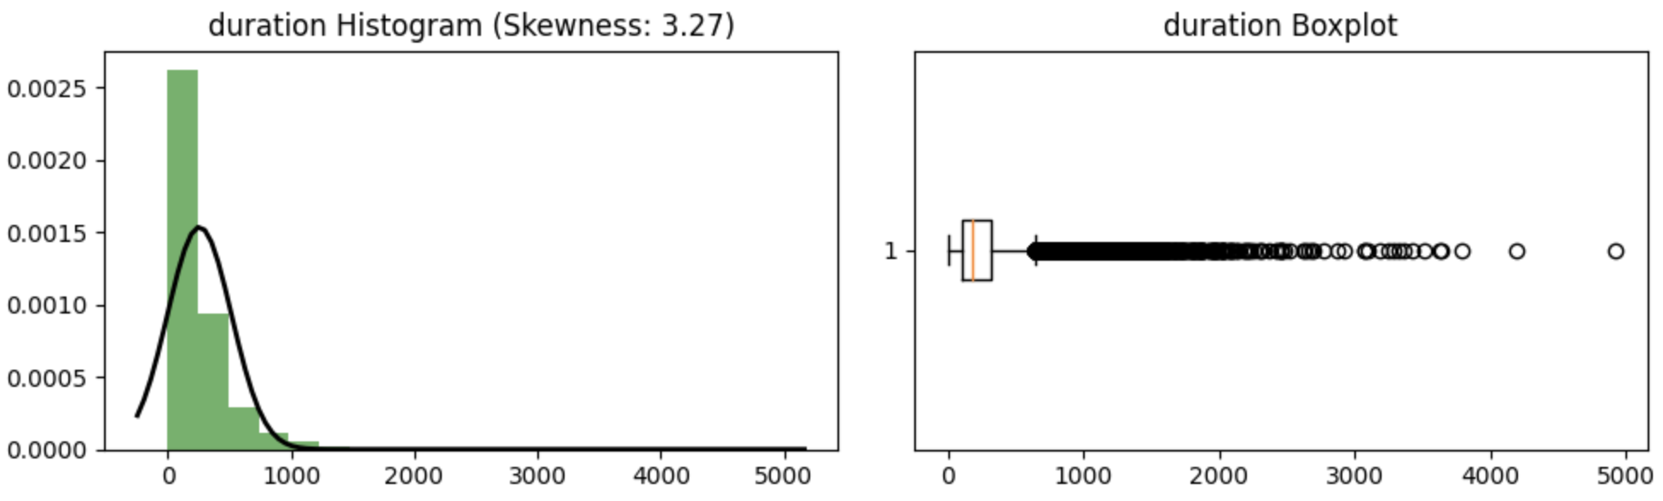
Duration
Duration is determined after the call is made. From the histogram, it is evident that many clients have not yet been contacted.

Slide 12
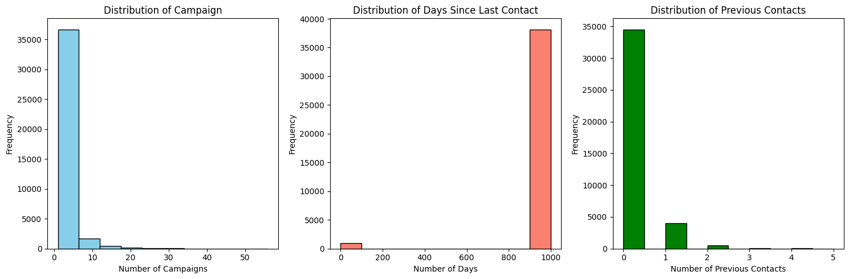
Campaign, Pdays, Previous
During this campaign, clients are contacted at most between 0 and 5 times. Many clients have not been contacted since the last contact was made, and numerous contacts had not been reached before this campaign was carried out.

Slide 13
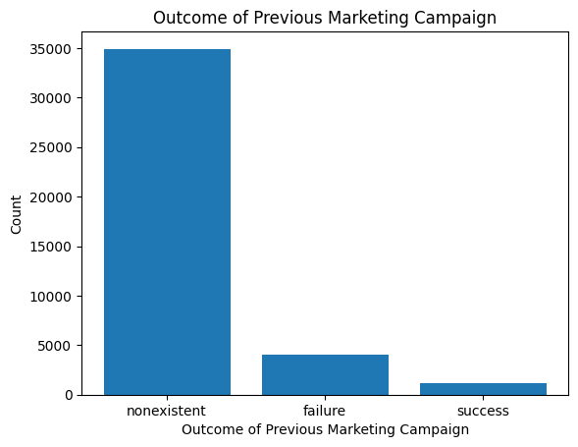
Poutcome
There have been more failures than successes in previous marketing campaigns.

Slide 14
ML Solutions
The preprocessing steps included:
Null value inspection.
Data type conversion.
Column selection.
Skewness examination and outlier removal for the "age" feature.
Categorical data encoding: 'yes' replaced with 1, 'unknown' with 0, and 'no' with -1 for the ['default', 'housing', 'loan'] columns; while employing One-Hot-Encoding for other columns due to their unordered nature.
Normalization to expedite convergence.

Slide 15
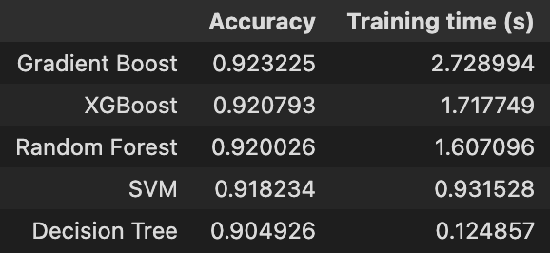
ML Solutions
The modeling process was conducted in two stages, where both "duration" and non-"duration" scenarios were explored.
For models involving the "duration" feature, Decision Tree, Random Forest, Linear Support Vector Machine (SVM), XGBoost, and Gradient Boosting algorithms were employed. Upon utilizing default parameters, the best-performing model produced the following results:

Slide 16
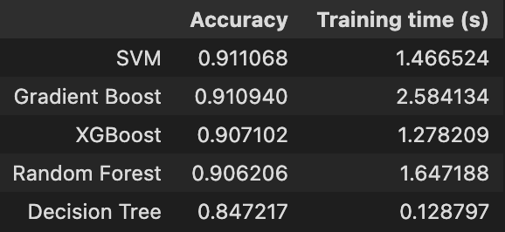
ML Solutions
For the model without the "duration" feature, employing the same set of algorithms, the outcomes were as follows:
The exclusion of the "duration" feature from the analysis was deliberate, as its inclusion would have added complexity to the process. Additionally, "duration" is only ascertainable post-call. Among the models evaluated, SVM emerged as the top performer. Consequently, the next step involved parameter tuning specifically for the SVM algorithm.

Slide 17
ML Solutions
The parameters utilized in the hyperparameter tuning process are:
Params | Value
C | 1, 0.1, 0.001, 0.0001, 0.00001, 0.000001
Kernel | Linear, poly, rbf
Gamma | Scale, auto
Random state | 42
The hyperparameter tuning process yielded the optimal result: {'C': 0.001, 'gamma': 'scale', 'kernel': 'poly', 'random_state': 42}, achieving an accuracy of 91%. Despite exhaustive tuning efforts, the accuracy did not exhibit a notable improvement.

Slide 18
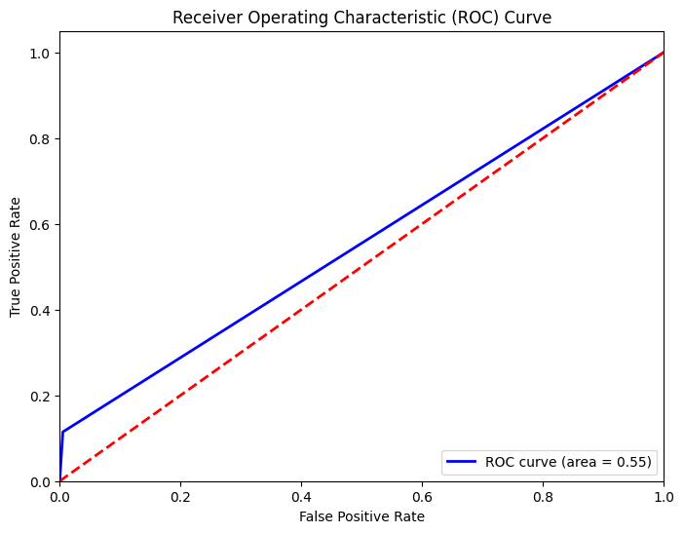
ML Solutions
Despite implementing this method, the ROC results did not reach their optimal performance.

Slide 19
Code Link
https://github.com/MuhammadNurilHuda/Bank-Marketing-Campaign

Slide 20

Thank You

